Slide 1

Toby Batty
Competency Portfolio
www.infratec-uk.com

Slide 2
Competency Summary
Category | Accreditation Body | No. | Expiry
Emergency First Aid at Work | Qualsafe | 3531226 | 10/12/27
Safe Moving and Handling | Qualsafe | 3531171 | 12/12/27
Working at Height | Qualsafe | 3533693 | 11/12/27
Highways Passport | National Highways | 14-00071013 | 09/12/27
Working Safely | IOSH | WS719310 | n/a
ECS – Highways Electrical Registration Scheme (HERS) | CSCS | H1243581 | 20/01/28
www.infratec-uk.com

Slide 3
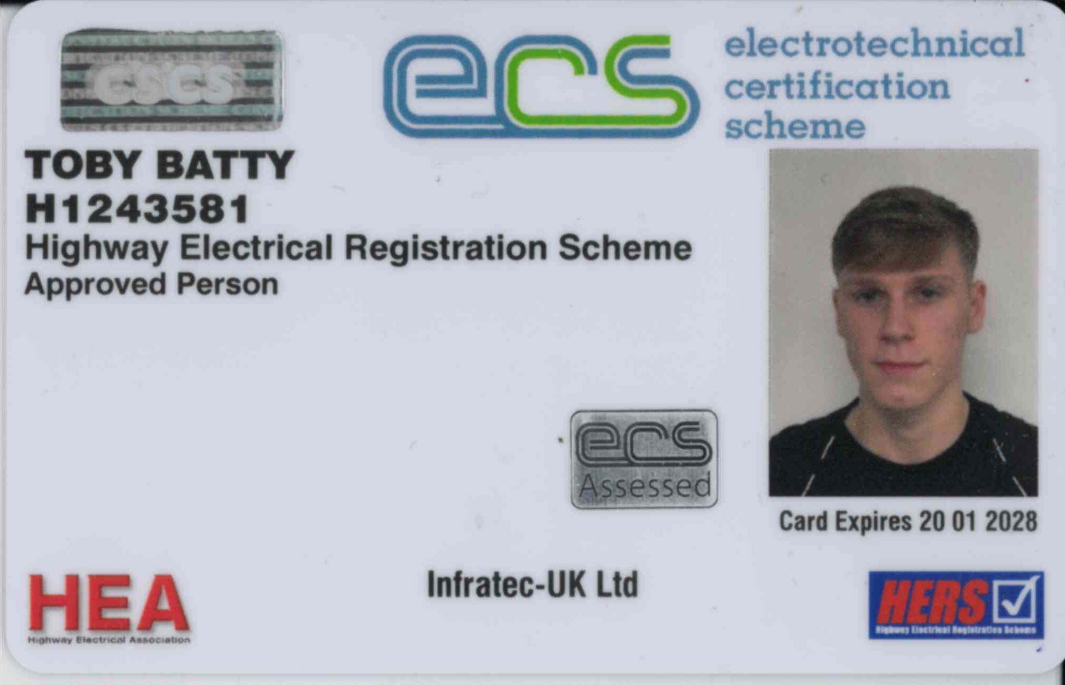
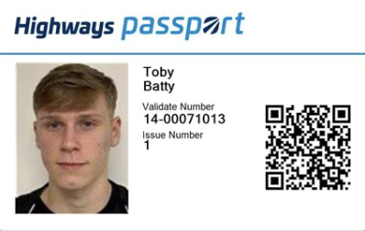
Competency Cards
Highways Passport
ECS
www.infratec-uk.com

